Slide 1
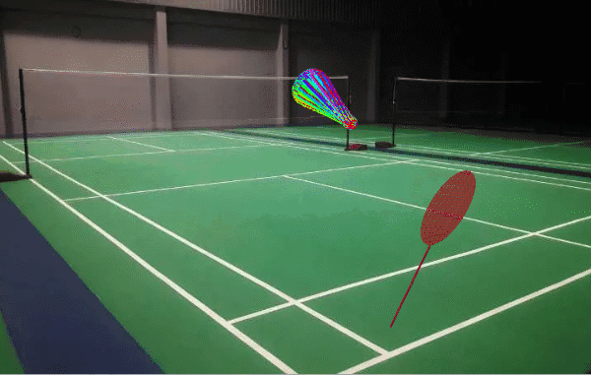
P1
<Computational Design Thinking>
<Generative Design>
P1
Assignment
Context
Course
Date
Generative
Design
Freshmore
Term 1
Computational
Design Thinking
2023
Student
<Description>
My design is a racket hitting a shuttlecock. The shuttlecock was generated using combination of polygons and extrusions. Generation of the object can be controlled with input variables to differ its length or even create a ball. The colour was determined by the angle of the extrusions of the object from the range of 0 to 360 degree.
The racket was generated through the shape difference with a grid and an ellipse, and its handle was generated with a cylinder.
The animation was generated through using the sine and cosine graph that was set against time to create the oscillating motion.
Song Wei Jie Eddy
1007957
Instructor
Geraldine Quek
Instructor

Slide 2
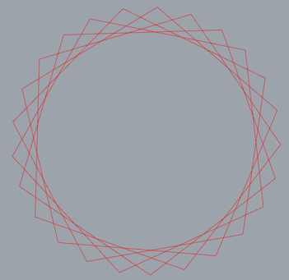
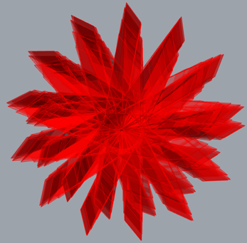
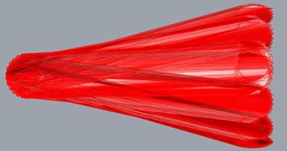
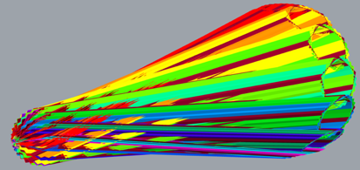
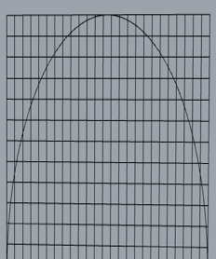
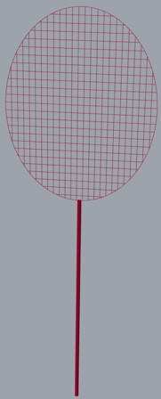
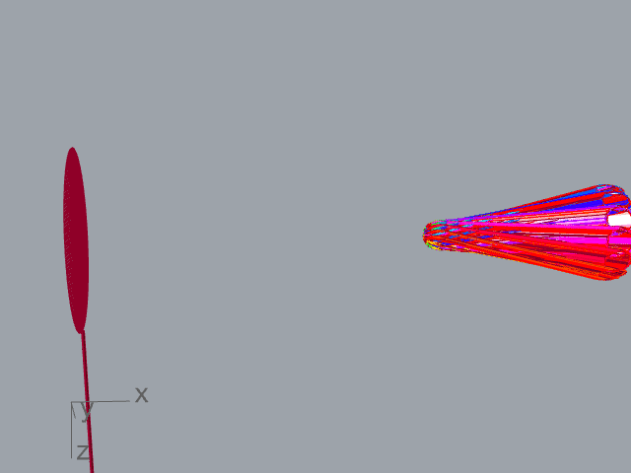
P2
<Computational Design Thinking>
<Generative Design>
P2
References
<Process of Design Thinking>
Previously when I first started on this project, I had planned to create a crystal shaped ball. I experimented with extruding the the many pentagons and rotating multiple copies of the extrusion to form the crystal ball.
However, when I was creating the crystal ball the result was very different from what was I expecting as I was still very new to the grasshopper program. Through numerous experimentation, I managed to obtained the crystal ball.
Afterwards due to my curiosity, I wanted to see what other shapes could I create by adjusting with the number sliders on the length of the extrusions and result of that experimentation was the creation of the shape of a shuttlecock.
After deciding to stick with the shape of the shuttlecock, I added colours for the shuttlecock. I used the series command block to help vary the colours based on the angle of each pentagon is in the circle.
Thereafter, I decided to create the racket for the shuttlecock. At first, I tried to form points on the ellipse by dividing it and then connect the points. However due to grasshopper’s way of connect the lines based on the order of which the points were created, thus the shape that I had in mind did not get generated. Hence, I experimented with many ways and finally I managed to get the shape but using the brep curve command which solved the intersection between the grid and the ellipse and created the netted part of the racket.
Lastly, I created a animation for the racket to hit the shuttlecock. I used a data recorder and a trigger to create a number list that would run continuously with time. Then I made used of the mathematical function of a sine and cosine graph along with the number list to create a oscillating motion of the the racket hitting the shuttlecock when it approaches the racket.
The following slides will show the working code design that had been created to generate and put everything together to form my project.
References
(Calculator Group LLC, 2023)
Captions
01 Pentagons
02 Crystal ball
03 Extruding outwards
04 Color with multiplier
05 Combining grid with curve
06 Racket
07 Racket hitting the shuttlecock
01
02
03
04
05
06
07

Slide 3
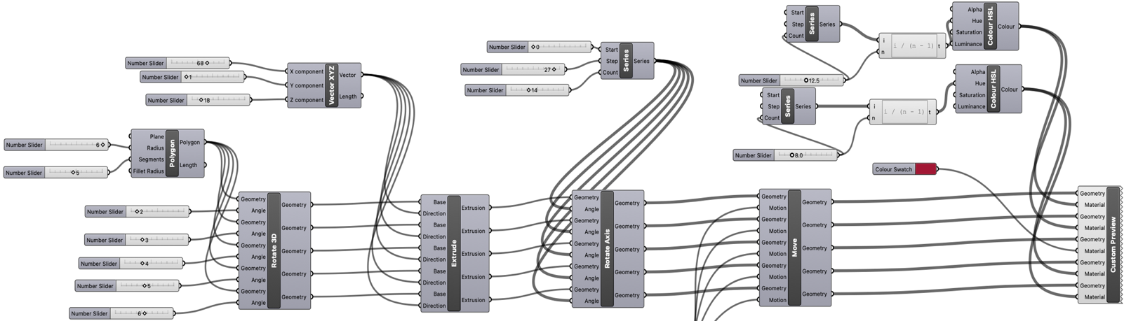
P3
<Computational Design Thinking>
<Generative Design>
P3
Colour Function
Extruding in the XYZ direction
Multiplying the extrusion
Initial shape
Animation
<Shuttlecock Code Design>
The 3D design is made from the manipulation of the base shape. The base shape was created by layering many pentagons that was displaced at different angles. Afterwards, the extrusion in the x axis, extends the base shape so that multiple copies of the extruded shape can be created, through the series command, and rotated to form the 3D shape of the shuttlecock. Then extrusion in the z axis helps to increase the diameter of the circle at the end of the shuttlecock. The series command was used in the colour function so that different colours would be displayed depending on the angle of the extrusions. The animation code will be explained in slide 5.

Slide 4
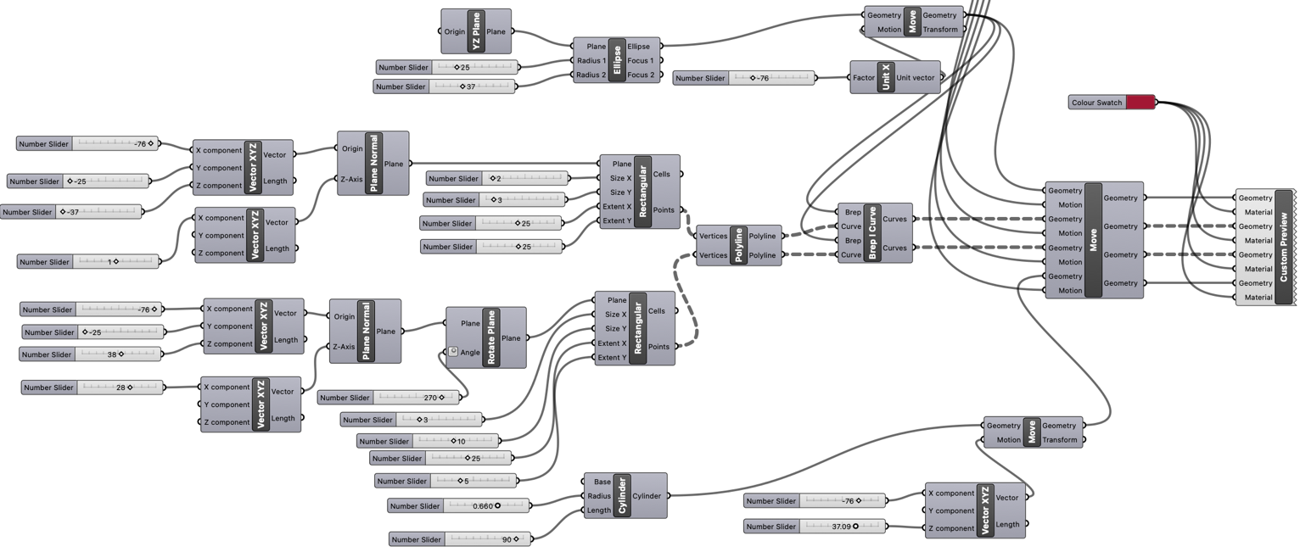
P4
<Computational Design Thinking>
<Generative Design>
P4
Racket base shapes
Setting Coordinates
Colour Function
Grid shape
Line generating
Combining the objects
Animation
Setting Coordinates
<Racket Code Design>
<Racket Code Design>
The 3D design of the racket was formed from three components. Firstly, grids were created to get the points which will help form the lines of the racket’s net. Secondly, the brep curve command help to create the netted part of racket which is the intersection of the grid and ellipse. Lastly, the cylinder forms the handle of the racket. The coordinates of the racket was also needed to be moved so that it does not overlap with the shuttlecock. The animation code will be explained in slide 5.

Slide 5
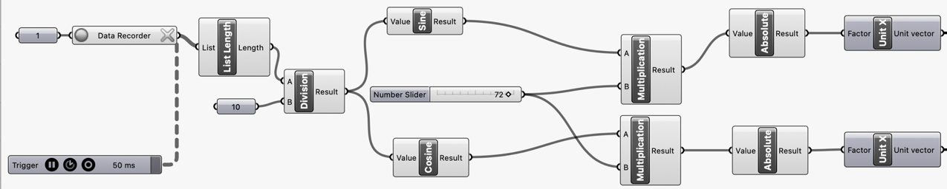
P5
<Computational Design Thinking>
<Generative Design>
P5
Generating a list against time
Creating coordinates that oscillates
Setting Coordinates to a plane
To Shuttlecock
To Racket
<Animation Code Design>
To form the animation of the shuttlecock and racket, I relied on a data recorder and a trigger to create a number list that would run continuously with time. This number list helps the animation to keeping moving. The number list was divided by 10 so that the animation will not move too fast. Afterwards, I made used of the mathematical function of a sine and cosine graph which was connected to the running number list to create opposing oscillating motions that simulates the racket hitting the shuttlecock when it approaches the racket. The multiplication of the sine and cosine graph is to increase the amplitude of the graphs thus increase the distance the two object will oscillate. Lastly, the absolute command is to ensure that the objects only oscillate on the x axis.

Slide 6
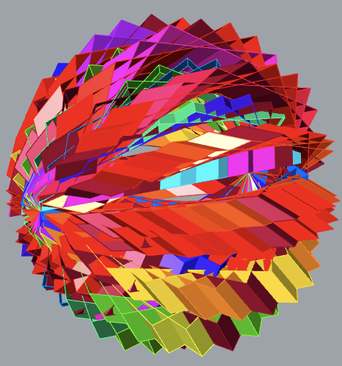
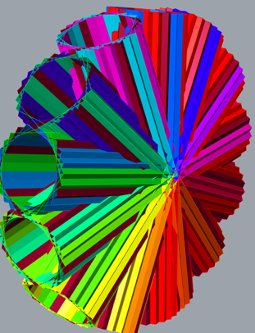
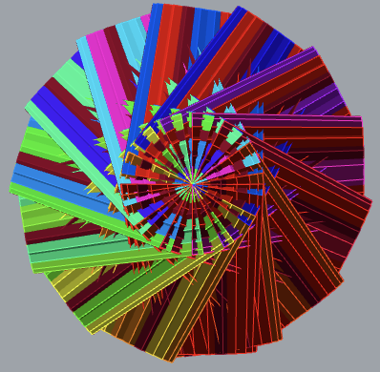
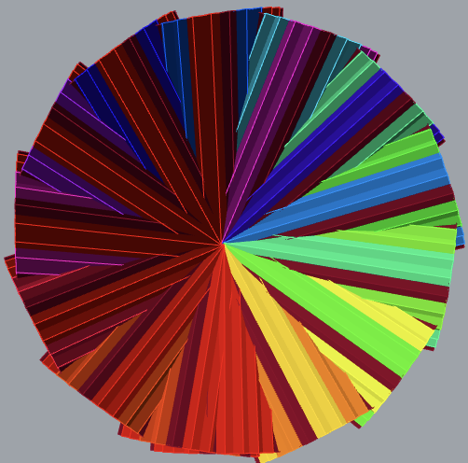
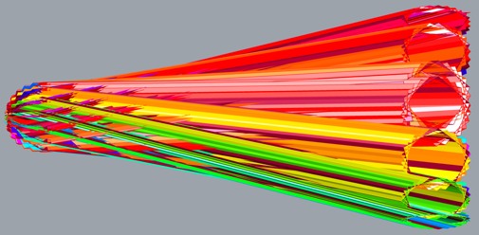
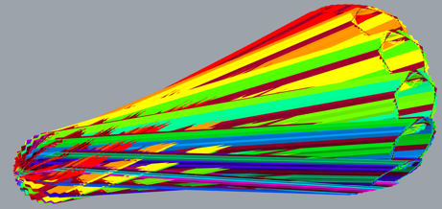
P6
<Computational Design Thinking>
<Generative Design>
P6
Captions
01 Shape without extrusion
02 Extrusion in z axis
03 Perspective from the front
04 Perspective from the back
05 Perspective from the top
06 Perspective from the side
01
02
03
04
05
06

